Slide 1
Financial
Counseling
Application
CFS
6
Second Edition
Updated July 2025

Slide 2
Agenda
Counseling Fundamentals
Open-ended Questions
Measuring Success in Counseling
More Financial Counseling Tools
Role-play Counseling Application

Slide 3
Counseling Fundamentals
Normalizing
Change
The client can solve their problem
Clients feel vulnerable
Couples have unique needs

Slide 4
Open-ended Questions
Do you
use
open-ended
questions?
When do you
use
open-ended
questions?
VS
SM
6-2

Slide 5
Measuring Success
Client actively participates
Clients takes ownership
Client prioritizes options
Positive change in mood, affect
and / or demeanor
Client verbalizes a sense of hope
Client willing to come back
Spouses reach consensus

Slide 6
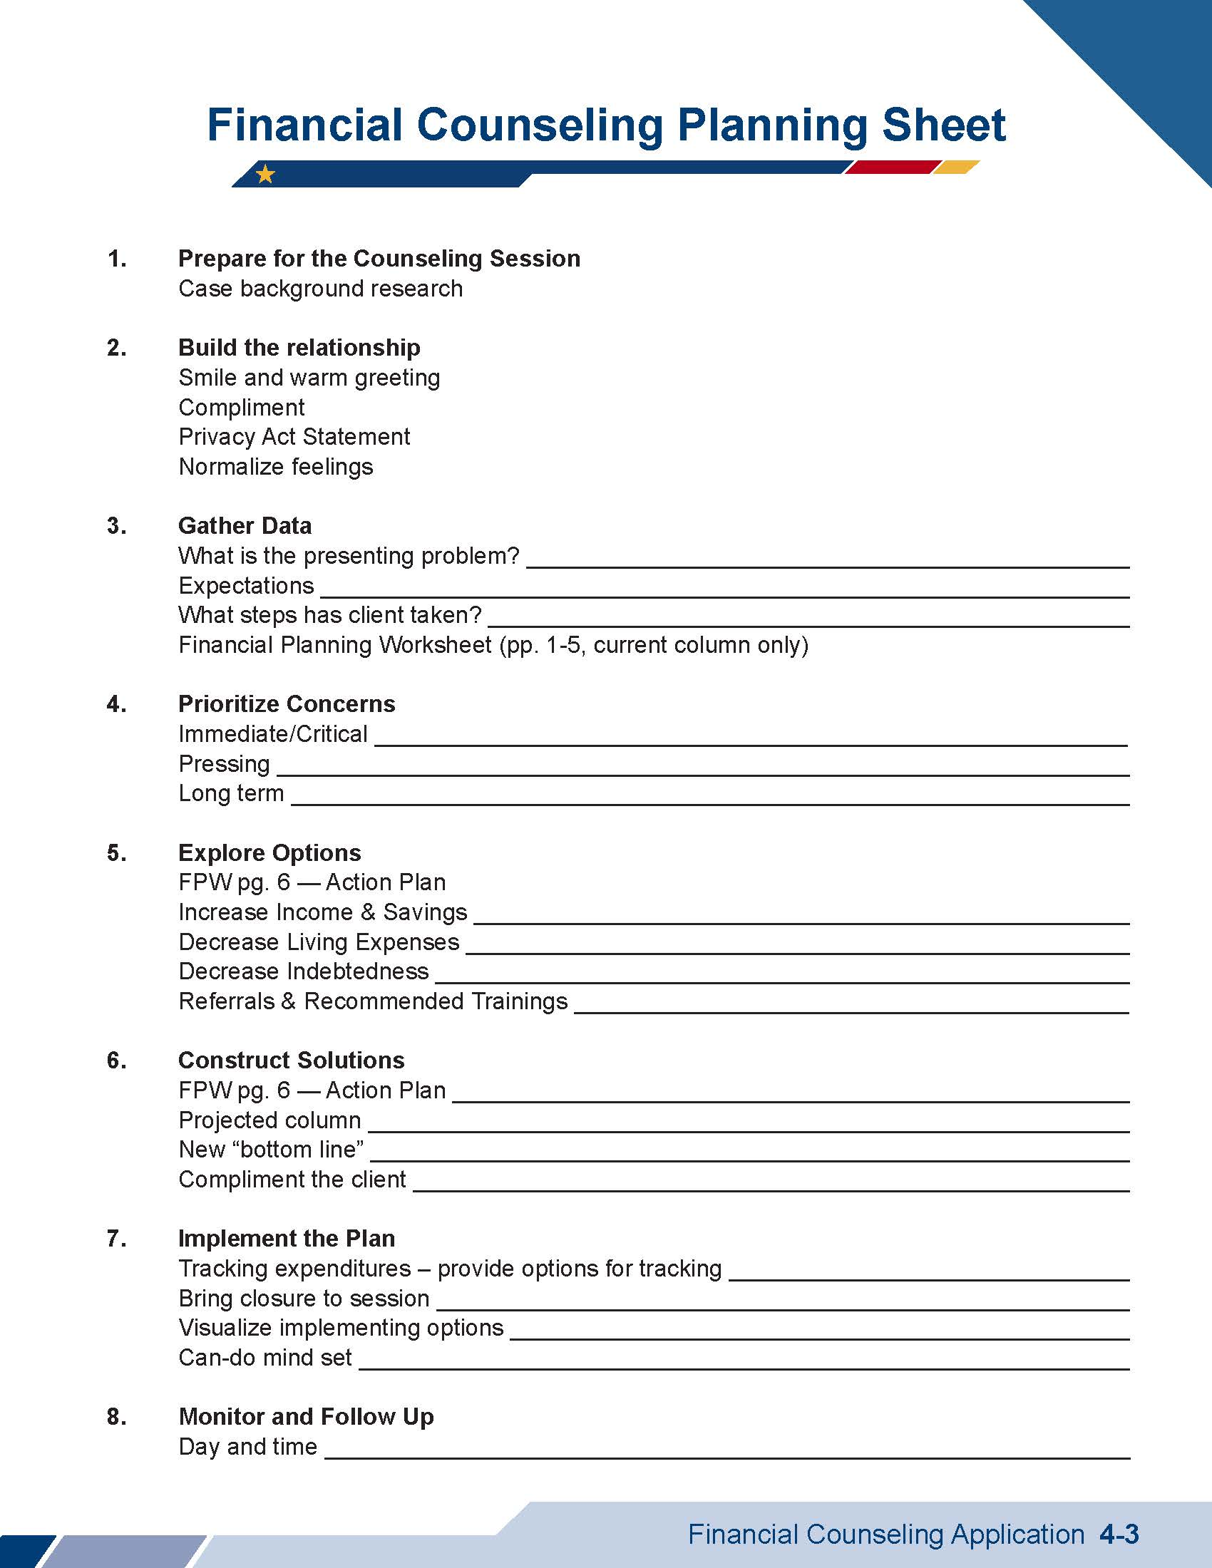
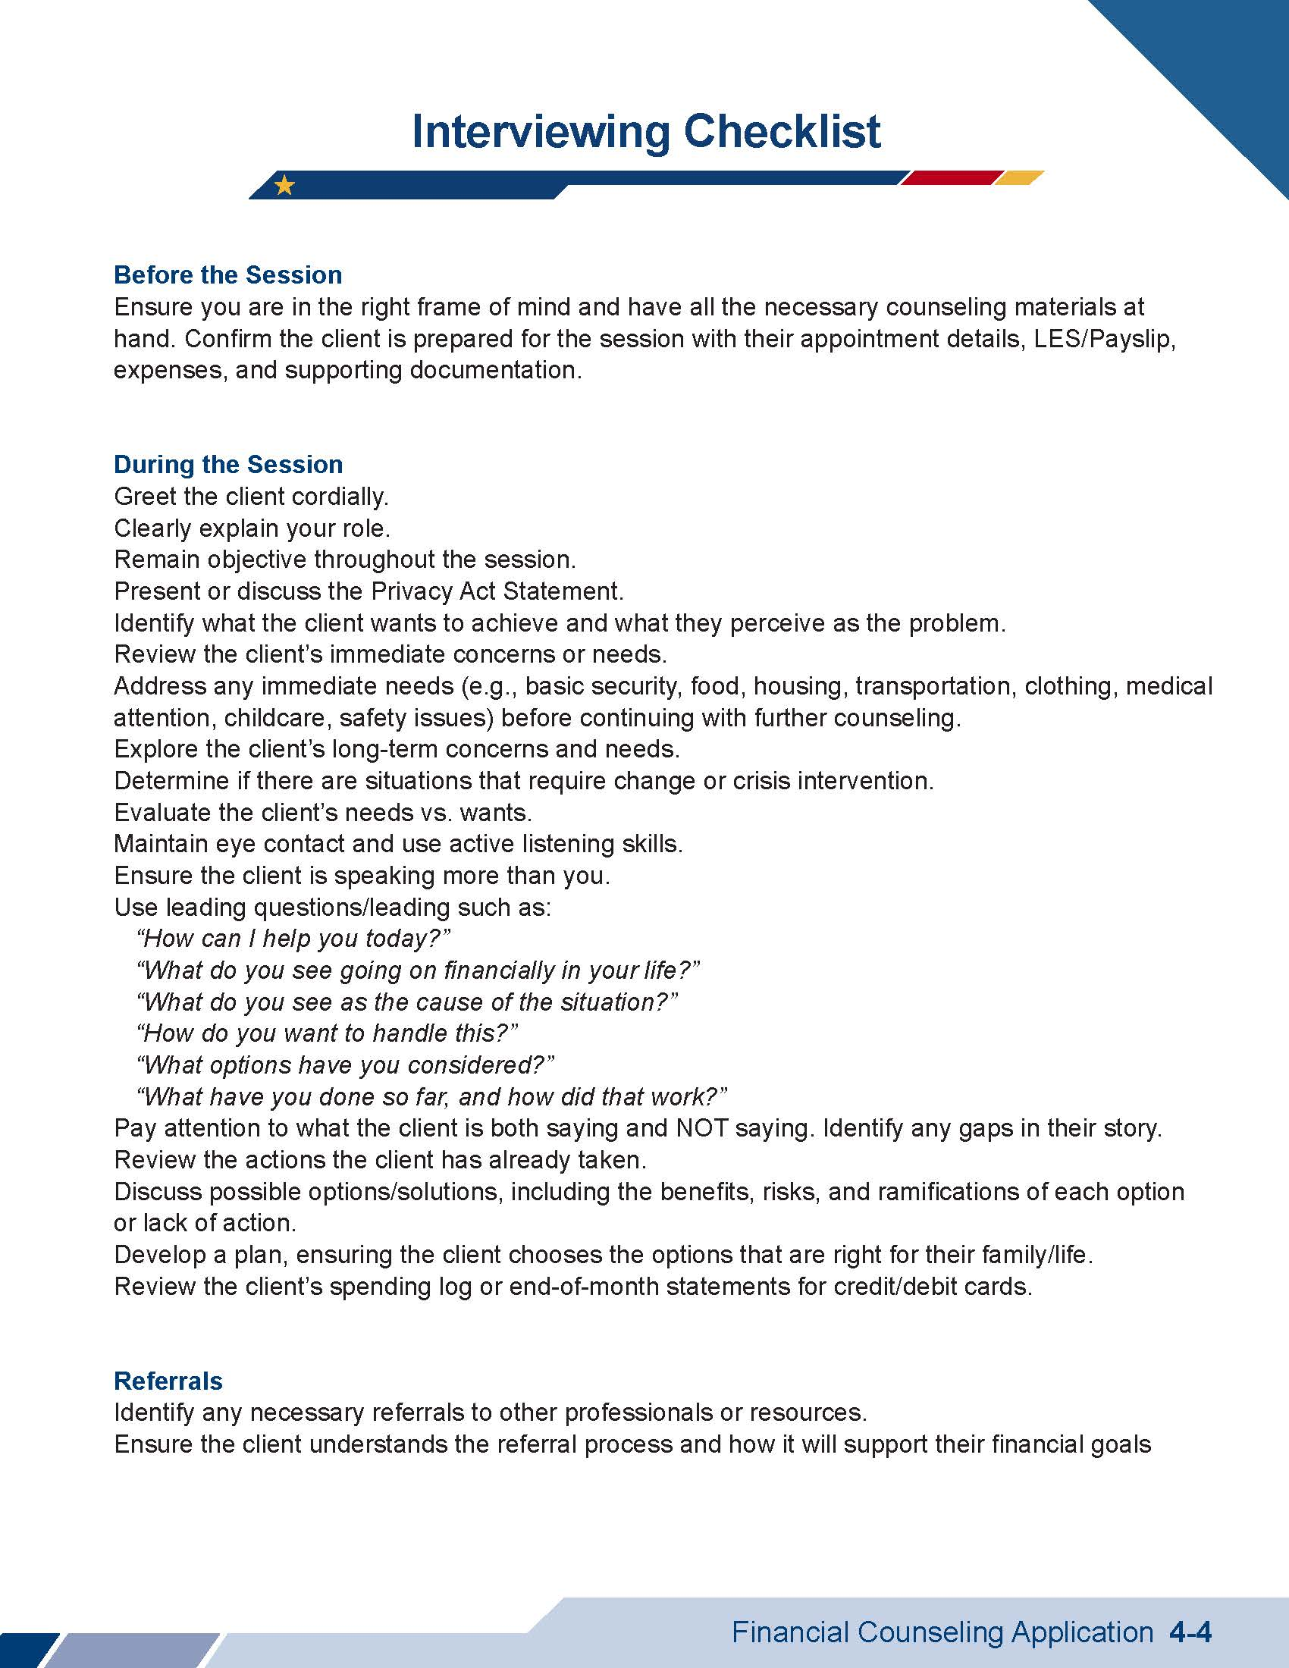
More Financial Counseling Tools
SM
6-3 to
6-4

Slide 7
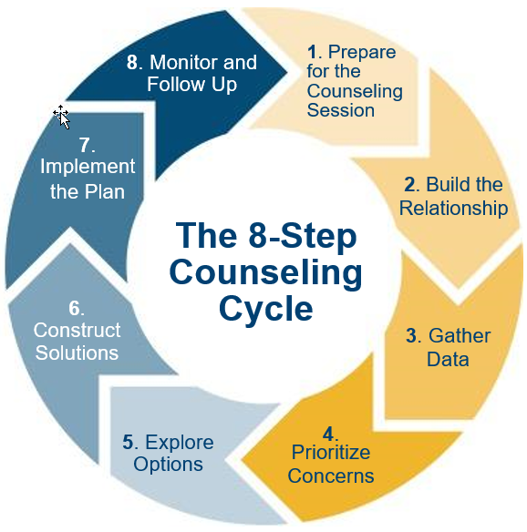
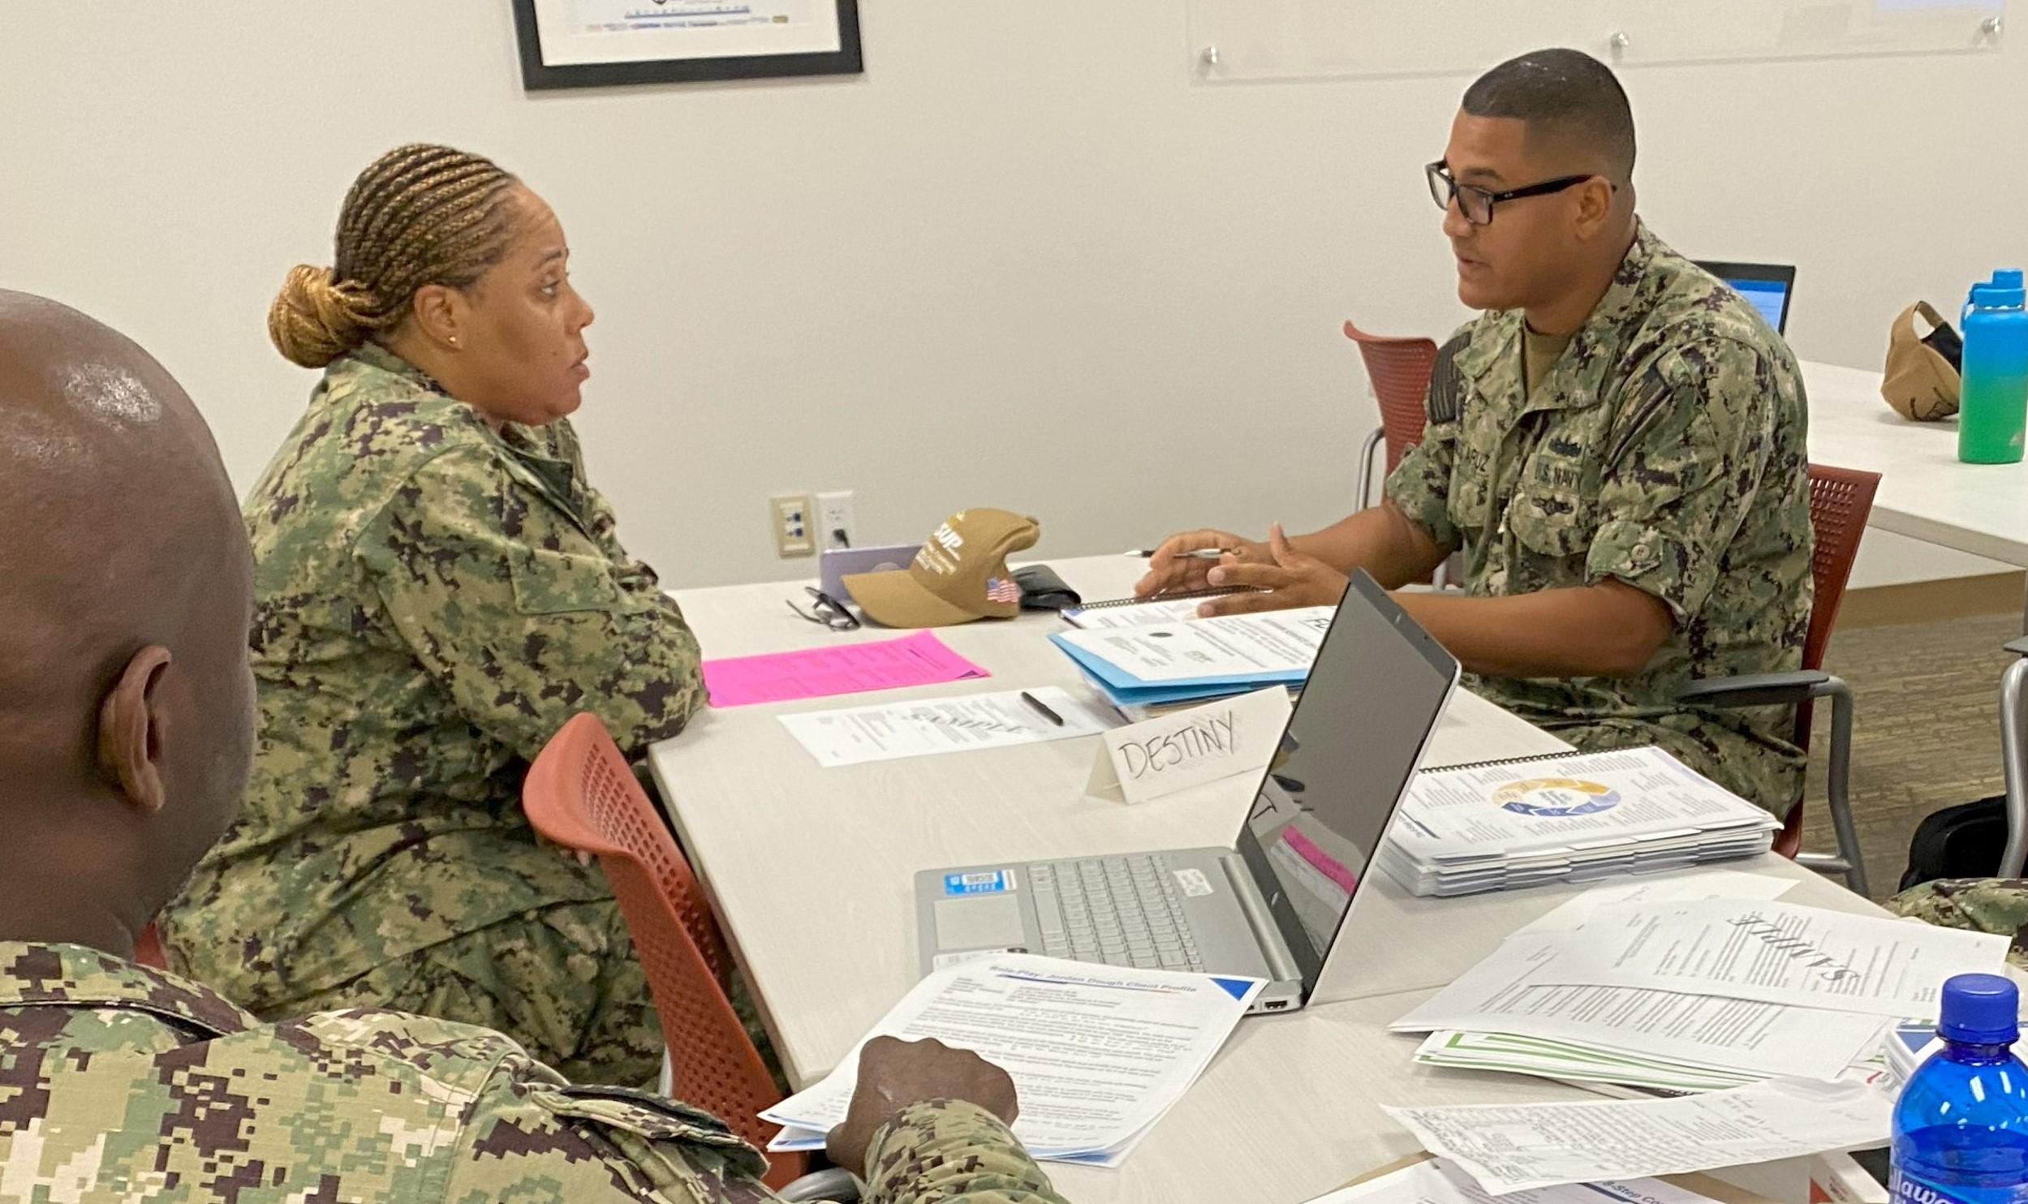
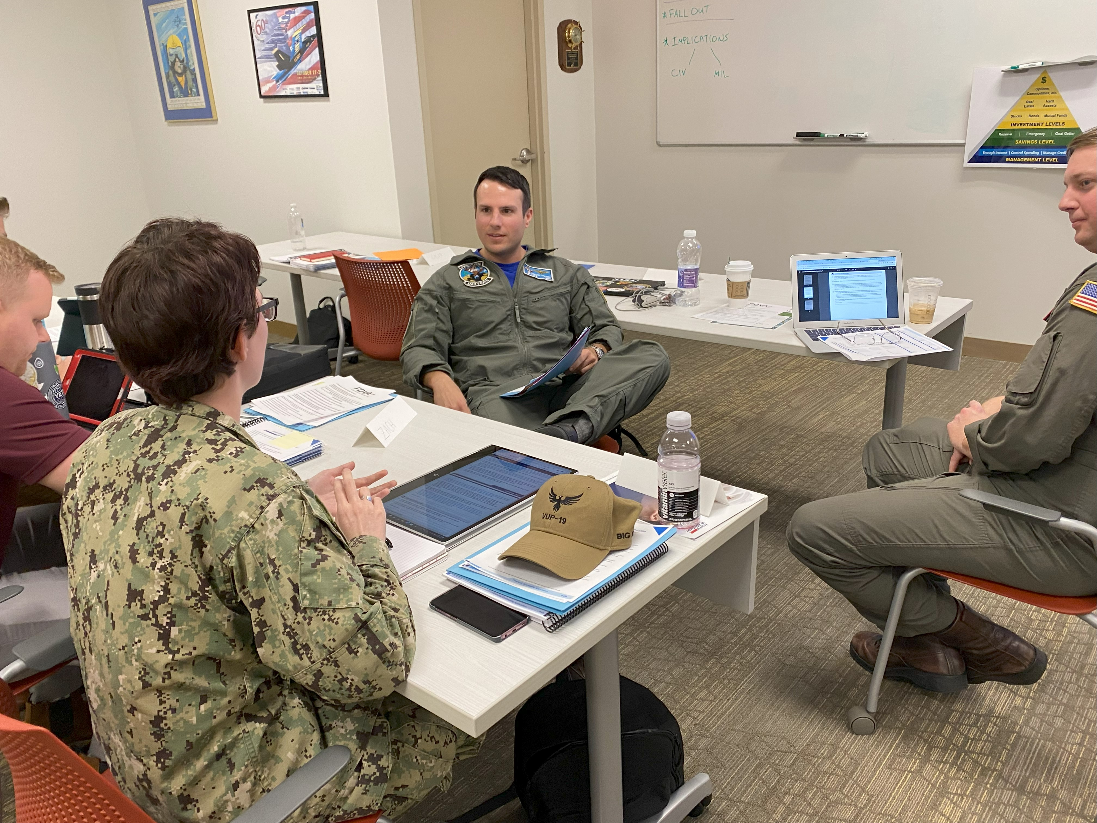
Activity: Role-play Counseling Application
Apply what you learned

Slide 8
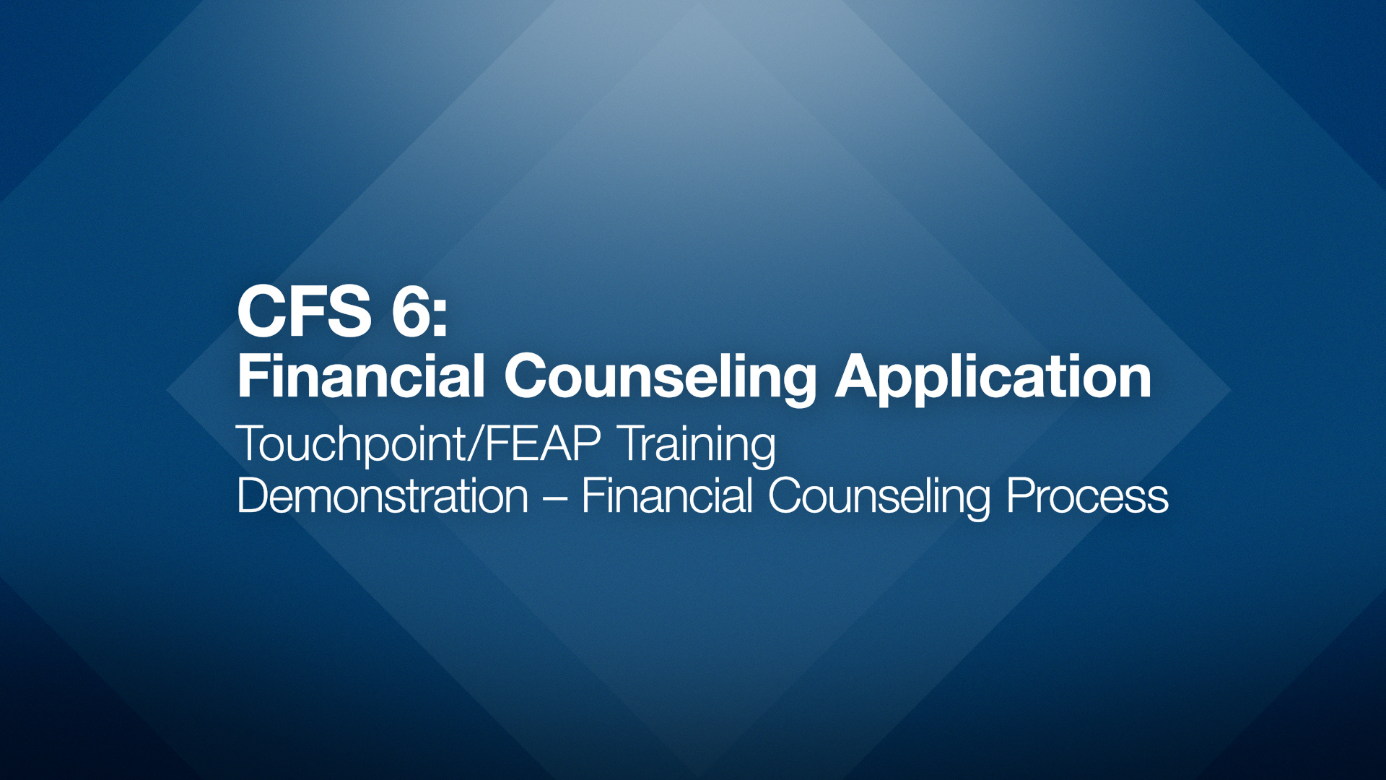
Demonstration Video

Slide 9
Counseling Role-play Procedures
The class will be divided into small groups, with three learners per group.
Each group will consist of an observer, CFS, and the client.
Each member will be able to practice their counseling skills as a CFS.
Roles are rotated AFTER each learner completes their CFS scenario.
The goal of this exercise is to practice applying the 8-step Counseling Cycle using common scenarios you will encounter as Command Financial Specialists.
SM
6-6

Slide 10
Counseling Role-play Procedures (cont.)
Each group will receive a client profile package that contains all the required scenarios, exercise objectives, and material needed.
Observers will use the evaluation form located in the Student Manual for feedback.
Allot 25 minutes for each session including the observer providing feedback before rotating roles.
SM
6-7

Slide 11
Role-playing Rules
As the client, your role is to realistically reflect the scenario without becoming combative or overly unreceptive.
CFS may ask for a “pause” if unsure how to proceed during the counseling process and discuss with the observer.
If the client requires an in-depth discussion on additional topics, referrals and scheduling additional appointments are an option.
Stay on topic. It is easy to go “down a rabbit hole.”

Slide 12
Role-play Review
CFS
Client
• Was this easy?
• Were you able
to complete
your scenario?
• Did the CFS meet
your needs?
• Did you trust the
CFS to discuss your
financial issues?

